Slide 1
DATA ANALYSIS COURSE
Group 4

Slide 2
STUDENT’S PERFORMANCE DATASET
Presented by Mercy Duru
Gabriel Obiagazie (Project Manager)
Moses Agbe Rukkayat Zakariyau
Nafiu Ishaq
Abdullahi Ahmed

Slide 3
OBJECTIVES
ACCESS GENDER, TEST PREPARATION COURSE,
AND LUNCH EFFECTS ON STUDENT’S PERFORMANCE.
2. INVESTIGATE ACADEMIC PERFORMANCE.
3. PROFER SUPPORT STRATEGIES.

Slide 4
ANALYSIS SUMMARY
The given data aims at understanding the effects of external factors such as gender, race/ethnicity, parental level of education,lunch and test preparation course on students performance in the highlighted subjects: math, reading and writing score.
The following results are used to deduce;
How effective the test preparation course was to the student’s performance
Which major factors contributed to the test outcomes
What would be the best way to improve student scores on each test

Slide 5
GENDER ANALYSIS
TOTAL NUMBER OF DATA = 1000
AVERAGE NUMBER OF FEMALES = 518
AVERAGE NUMBER OF MALES = 482

Slide 6
AVERAGE FEMALE SCORES
MATHS | READING | WRITING
63.63 | 72.61 | 72.47

Slide 7
AVERAGE MALE SCORE
MATHS | READING | WRITING
68.72 | 63.31 | 65.47

Slide 8
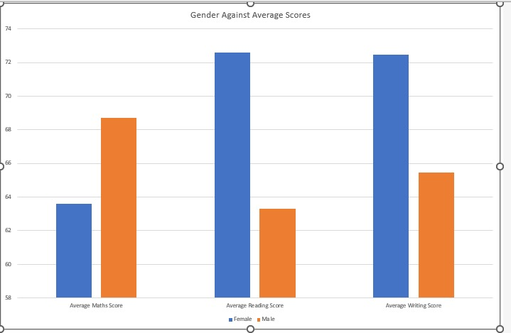
Graphical Representation of Gender Analysis

Slide 9
INSIGHT IDENTIFICATION
GENDER ANALYSIS
The data shows that male students performed better in maths while female students performed better in writing and reading.
SUPPORT STRATEGY
More attention should be paid to the females in calculative aspects while male students should improve on reading and writing subjects.

Slide 10
2. TEST PREPARATION COURSE ANALYSIS
AVERAGE NUMBER OF COMPLETED = 358
AVERAGE NUMBER OF NOT COMPLETED = 642

Slide 11
AVERAGE STUDENTS WHO COMPLETED THEIR TEST PREPARATION COURSE
MATHS | READING | WRITING
69.69 | 73.89 | 74.41

Slide 12
AVERAGE STUDENTS WHO DID NOT COMPLETE THEIR TEST PREPARATION COURSE
MATHS | READING | WRITING
64.07 | 66.53 | 64.50

Slide 13
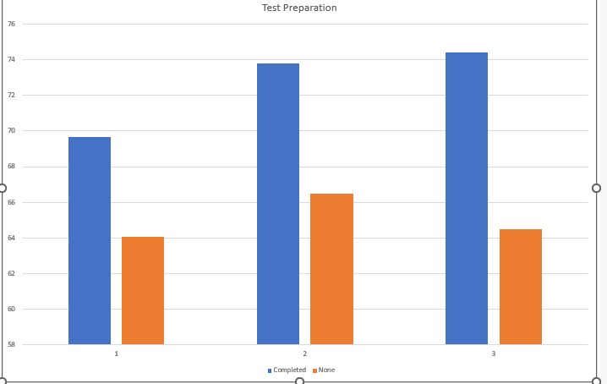
Graphical Representation of Test Prep Analysis

Slide 14
INSIGHT IDENTIFICATION
TEST PREPARATION ANALYSIS
The data shows that students who completed their test preparation course performed better than students who did no test preparation course.
SUPPORT STRATEGY
Students should attend test preparation courses as it improves general performance.

Slide 15
AVERAGES BASED ON STUDENT’S LUNCH PATTERN (STANDARD FEEDING)
MATHS | READING | WRITING
68.13 | 69.17 | 67.59

Slide 16
AVERAGES BASED ON STUDENT’S LUNCH PATTERN (FREE/REDUCED)
MATHS | READING | WRITING
56.50 | 61.6 | 58.73

Slide 17
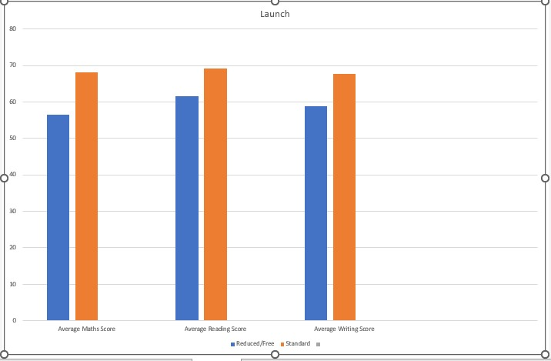
Graphical Representation of Lunch Analysis

Slide 18
INSIGHT IDENTIFICATION
LUNCH ANALYSIS
The data shows that students who ate standard lunch performed better than students who had free or reduced lunch.
SUPPORT STRATEGY
Students should be provided with more standard lunch as it improves general performance.

Slide 19
Summary
Several external factors can have great effects on students academic performance.
Therefore, parents and guardians can help boost a child’s performance by tweaking the external factors influencing the child.

Slide 20
Thank You

